Slide 1
Financial Performance Dashboard
Presented By
Vaishali A

Slide 2
PROBLEM STATEMENT :
  Many organizations struggle to monitor their financial performance effectively due to large volumes of sales and profit data. Management needs a centralized dashboard to track revenue, profit, sales trends, and regional performance in order to identify business opportunities, detect performance issues, and make informed decisions.
OBJECTIVE :
  The objective of this project is to develop an interactive Financial Performance Dashboard that:
  Monitors key financial KPIs such as Revenue, Profit, Profit Margin, and Growth.
  Analyzes sales performance across products, regions, and time periods.
  Identifies high-performing and low-performing business areas.
  Provides actionable insights to support strategic decision-making.
  Helps management improve profitability and business growth through data-driven analysis.

Slide 3
DATASET OVERVIEW
DATASET INFORMATION
  The dataset contains:
  Sales Transactions
  Product Information
  Country/Region Details
  Revenue
  Profit
  Discounts
  Date Information
DATA PREPARATION
  Removed duplicates
  Handled missing values
  Formatted date fields
  Validated business metrics

Slide 4
DASHBOARD OVERVIEW
Dashboard Sections
Top Section
    Revenue KPI
    Profit KPI
    Margin KPI
    Orders KPI
Middle Section
    Revenue Trend Analysis
    Profit Trend Analysis
Bottom Section
    Product Performance
    Profit Analysis

Slide 5
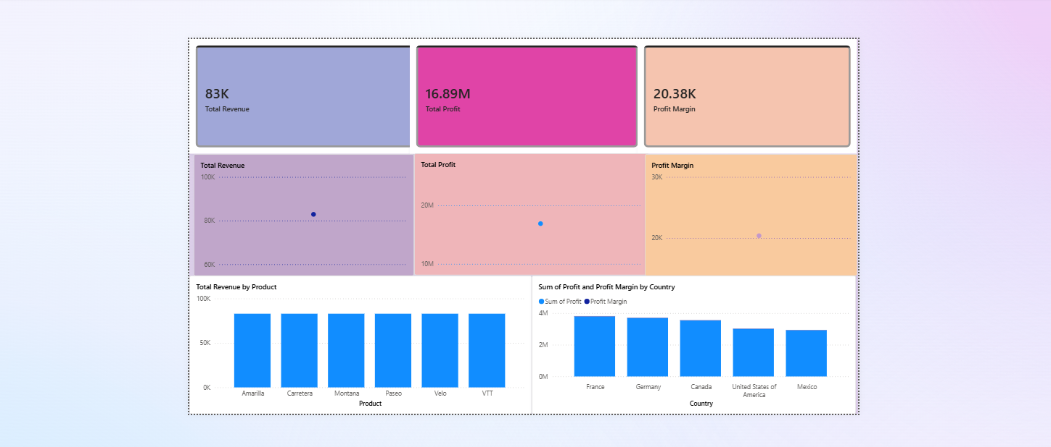
DASHBOARD

Slide 6
CONCLUSION
The Financial Performance Dashboard successfully provides a comprehensive view of the organization's financial health by analyzing key metrics such as Revenue, Profit, Profit Margin, and Sales Trends. The dashboard enables management to identify high-performing products and regions, monitor business growth, and detect areas that require improvement. Through data-driven insights and visualizations, it supports informed decision-making, enhances operational efficiency, and contributes to overall business growth and profitability.

